Slide 1




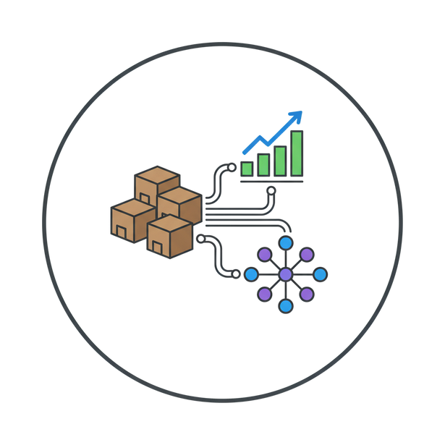
SMART INDIA HACKATHON 2025
  Problem Statement ID –25193
  Problem Statement Title - Forecasting materials demand with machine learning for supply chain planning, procurement, and inventory optimization.
  Theme-Smart Automation
  PS Category- Software
  Team ID - 84247
  Team Name - Xanthic

Slide 2







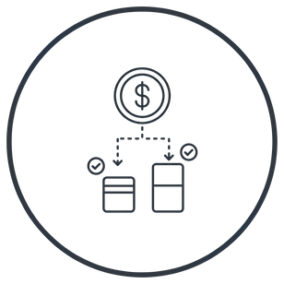


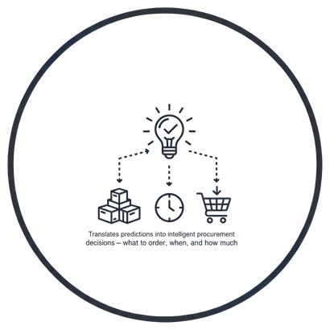



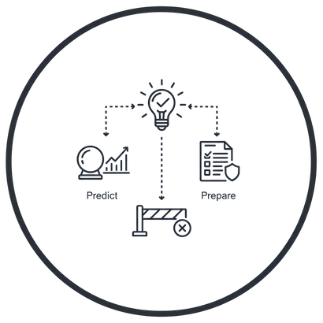



SupplySense
XANTHIC
ANALYZE. ANTICIPATE. ACT.
OUR SOLUTION
HOW IT SOLVES THE PROBLEM
UNIQUE VALUE PROPOSITION
Forecasting the need before it appears.
Trained specifically for POWERGRID’s material and project patterns
  Reduces shortages & overstock
Translates predictions into intelligent procurement decisions. [what to order, when, and how much]
  has adaptive ML that predicts material demand.
  Improves cost efficiency
  Integrates with ERP/project data.
  has Real-time dashboard & alerts.
  Supports planners with actionable insights
  Prioritizes critical materials and procurement schedules to avoid delays.
Charts, heatmaps, KPIs (shortage risk, overstock %, predicted demand).
  Minimizes project delays by ensuring timely material availability
  Analyzes historical trends and seasonal patterns to improve forecast accuracy.
Run “what-if” simulations. Predict. Prepare. Prevent.
  Generates automated reports and recommendations for planners and managers.
  Enhances budget utilization and resource allocation across projects
@SIH Idea submission
2
Notes:
2

Slide 3
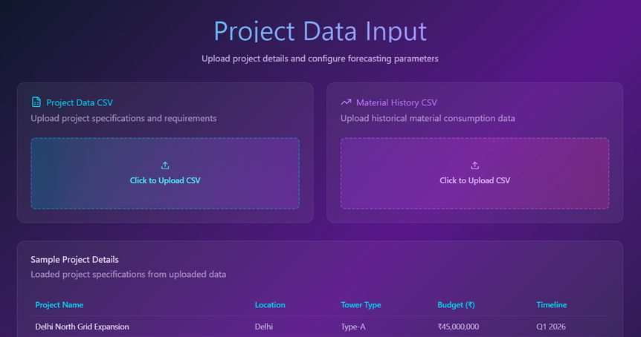
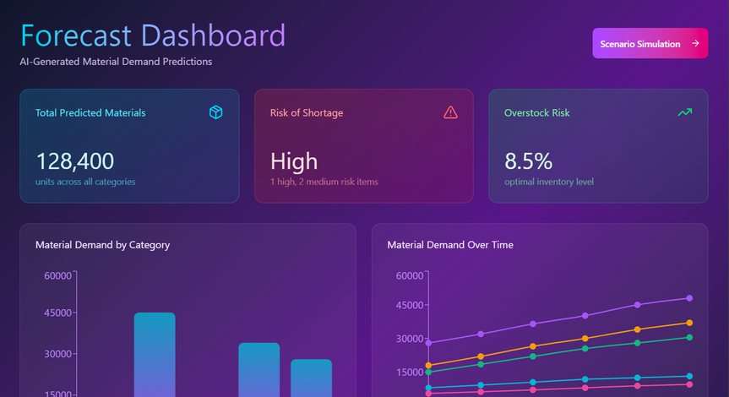
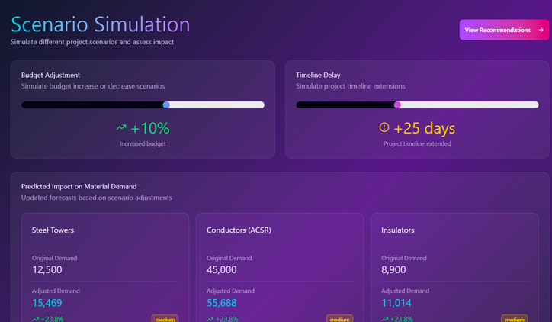
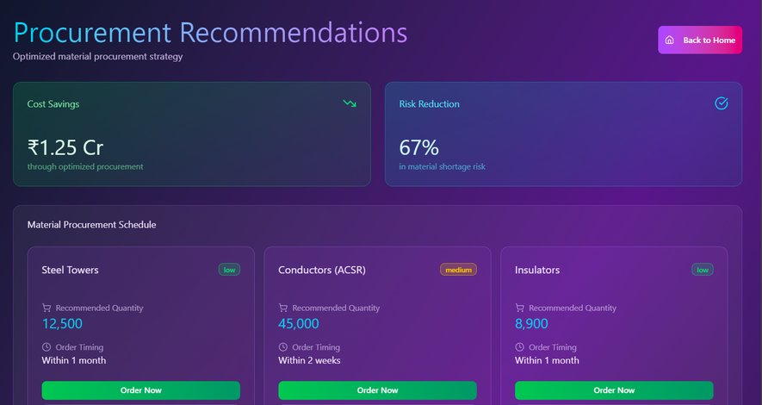
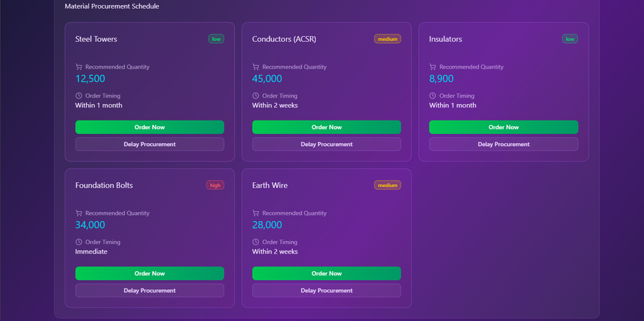







TECHNICAL APPROACH
XANTHIC
@SIH Idea submission
3
Notes:
3

Slide 4
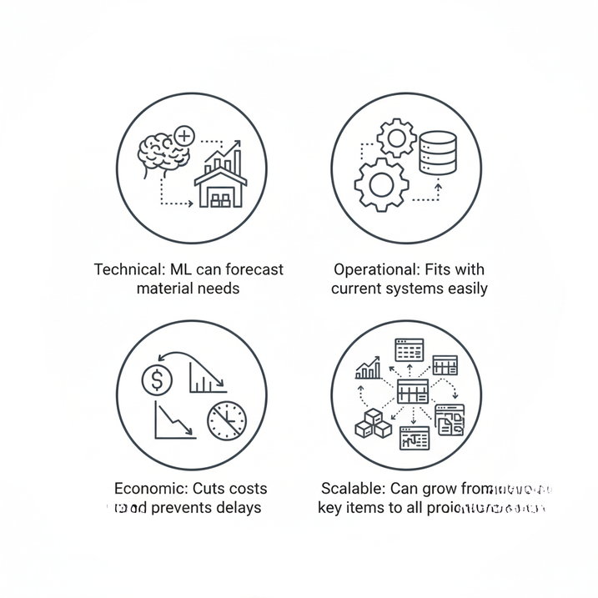
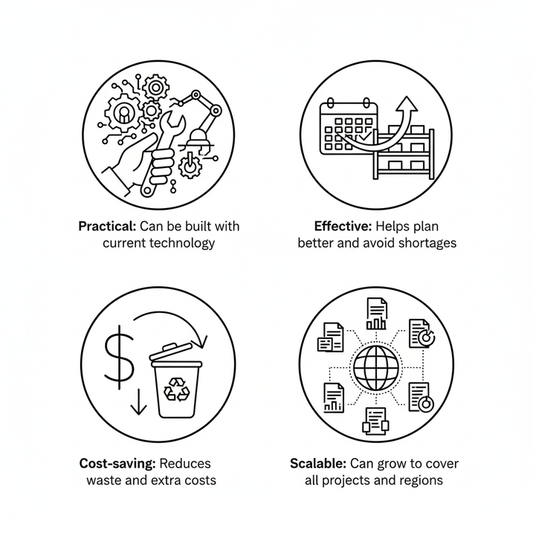
FEASIBILITY AND VIABILITY
XANTHIC
Feasibility Analysis
Viability Analysis
Practical: Can be built with current technology.
Effective: Helps plan better and avoid shortages.
Cost-saving: Reduces waste and extra costs.
Scalable: Can grow to cover all projects and
regions.
Technical: ML can forecast material needs.
Operational: Fits with current systems easily.
Economic: Cuts costs and prevents delays.
Scalable: Can grow from key items to all projects.
@SIH Idea submission
4
Notes:
4

Slide 5
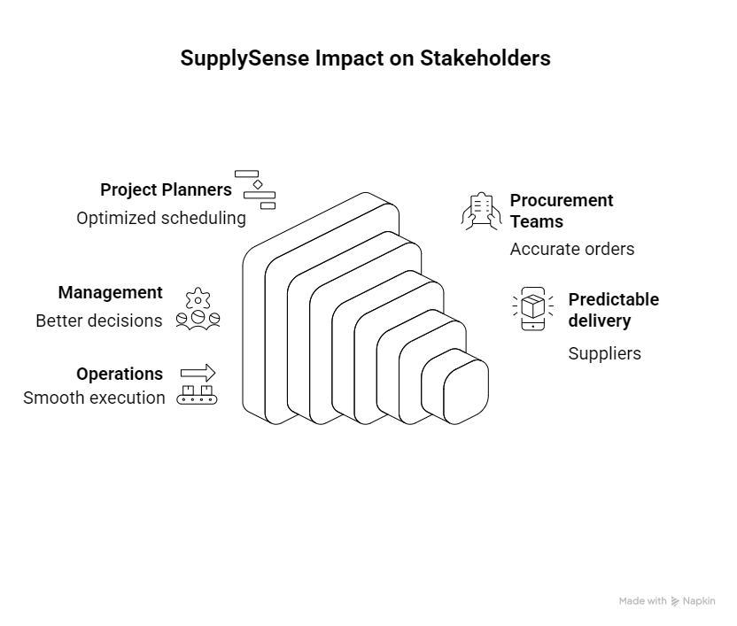
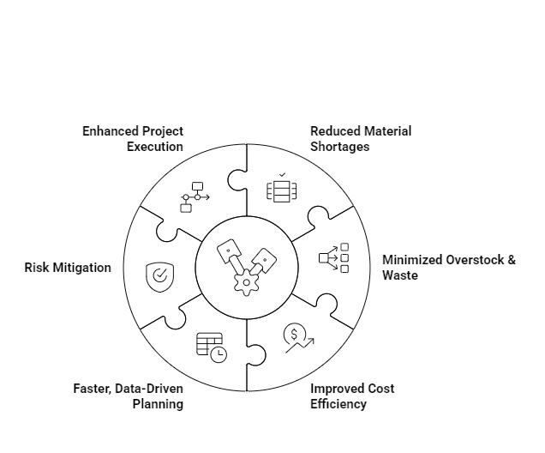
IMPACT AND BENEFITS
XANTHIC
Impact of SupplySense on Stakeholders
Benefits at a Glance
@SIH Idea submission
5
Notes:
5

Slide 6
RESEARCH AND REFERENCES
XANTHIC
  Machine learning demand forecasting and supply chain performance
  https://www.tandfonline.com/doi/full/10.1080/13675567.2020.1803246
  Hybrid ML (ARIMAX + Neural Network) mitigates the Bullwhip Effect and yields tangible improvements in supply chain performance and financial metrics.
  Inventory management and cost reduction of supply chain processes using AI based time-series forecasting
  https://doi.org/10.1016/j.promfg.2020.01.034
  An ANN model uses time-series forecasting to minimize supply/demand mismatch, effectively reducing inventory and shortage costs to increase profit margins.
@SIH Idea submission
6
Notes:
6

